Slide 1

Ngo tekno
JOHAIL SHERIEFF MEHABOOB SHERIEFF
KIRAN KUMAR KATHIRESAN
RAJSHARAVAN SENTHILVELAN

Slide 2
Problem Statement
To address the health issues of homeless people is a very challenging health problem in recent year as US Department of Housing and Urban Development (HUD) reported that 564,000 people are homeless in the United States.
In the recent years the lack of health insurance is the most common reason for homeless people to not get access to proper healthcare.

Slide 3
Approach
To make health care feasible for homeless people in the United States with the help of an NGO volunteers and collaborating it with the Hospital networks.
The first process involves diagnosing the health issue of the homeless people and later the NGO selects a particular set of people based on the level of exposure to the disease.
Finally, the hospital helps in curing their diseases identified by criticality and priority based on the age difference.

Slide 4
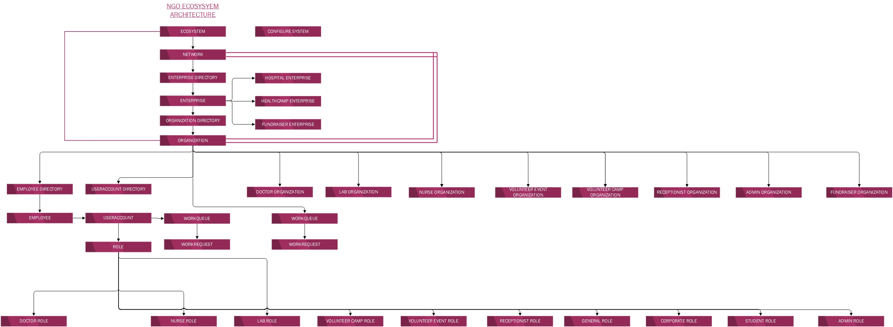
Object model

Slide 5
Usecase Functionalities
Adding the volunteers as a workforce in the NGO, where the volunteers conduct surveys on each areas or location to find out how much homeless are affected in each region and send a request to NGO to setup a health camp with the support of the collaborated hospital
In the health camp, volunteers first take homeless people into account and conduct a free health check up which is done by the nurses
After health check up, nurse sends back the detailed report of each homeless to the NGO based on the checkup report and approx. diagnosis depeding upon the symptoms

Slide 6
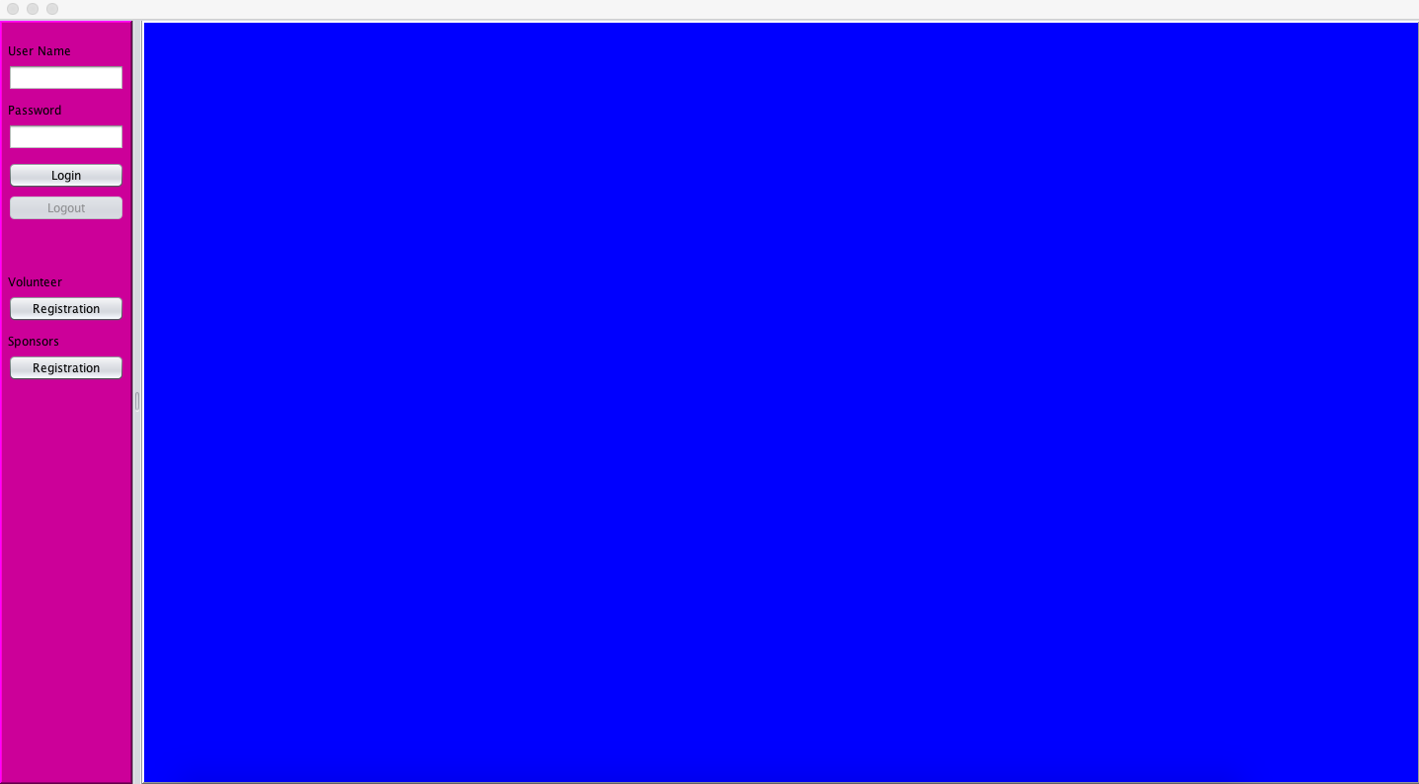
Usecase Functionalities(Continued)
NGO identifies critical patients from the report, considering the funds available and if there are no funds available the NGO hosts a fundraiser event depending upon the approx. fee amount for each patient
After the funds are collected issues they issue them a NGO health card for further treatment in the respective hospital
Report will be sent to the hospital by NGO and the treatment process gets started here.

Slide 7
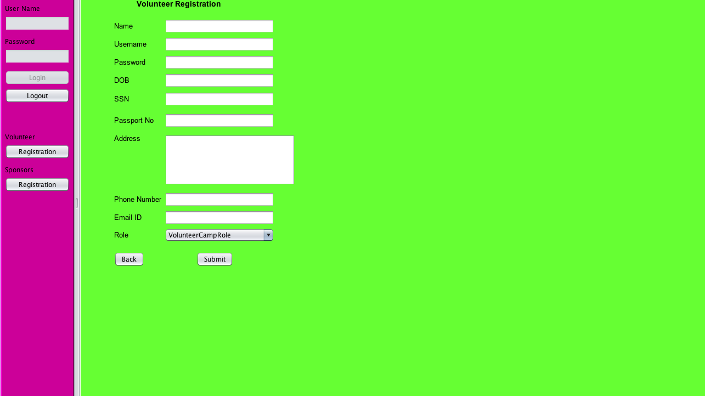
Camp and event volunteer registration

Slide 8
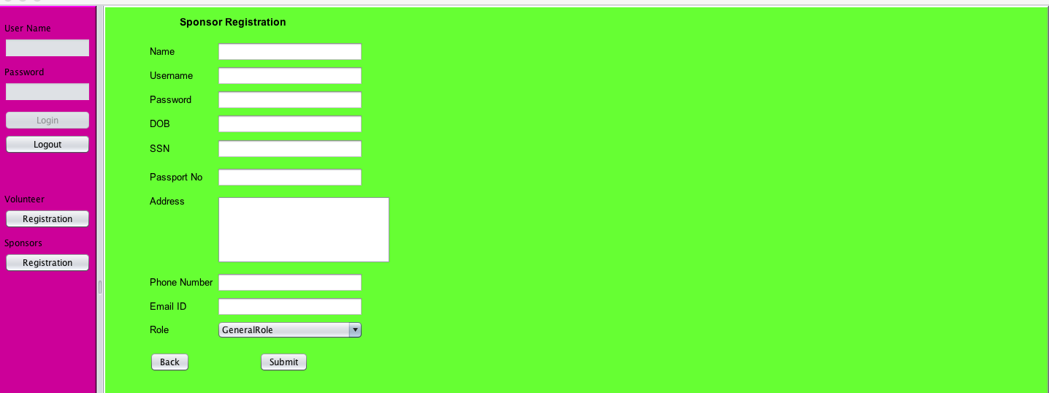
Sponsor registration

Slide 9
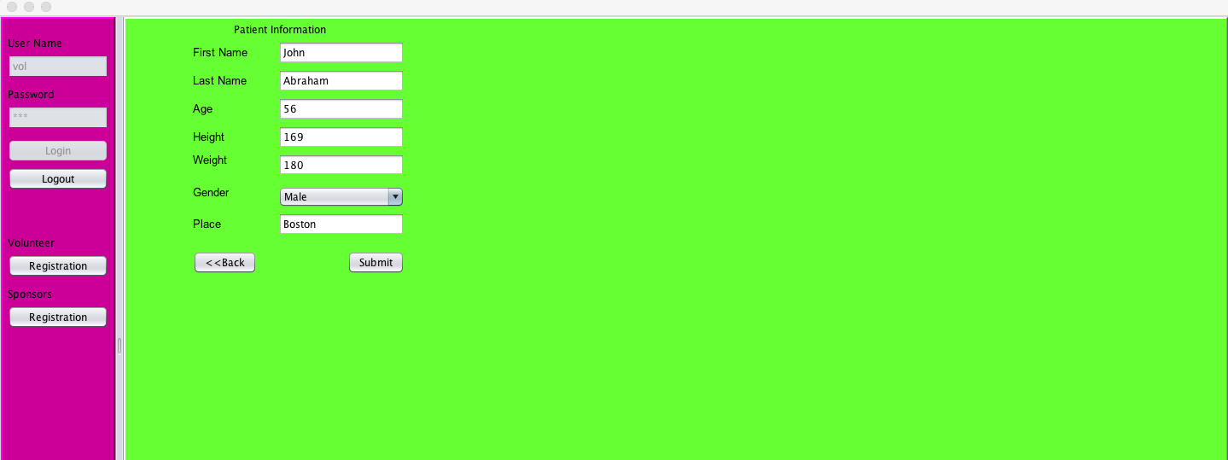
Patient information panel

Slide 10
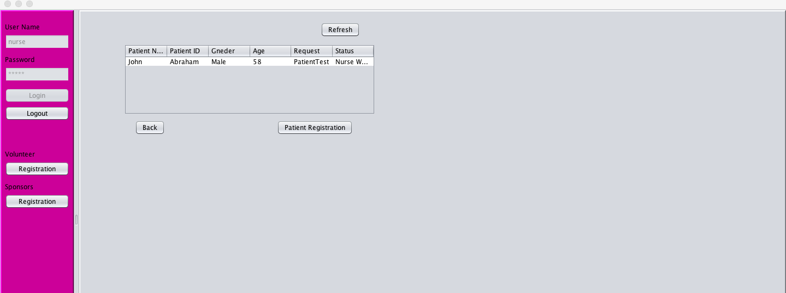
Nurse request table

Slide 11
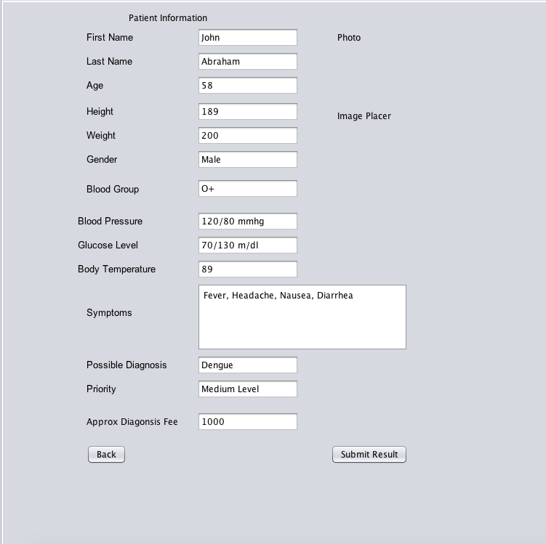
Nurse Entering patient details

Slide 12
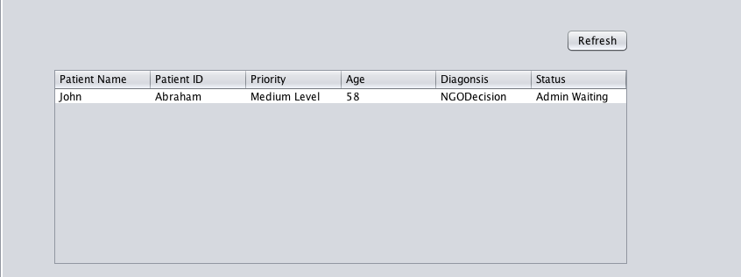
Fund Request for patient

Slide 13
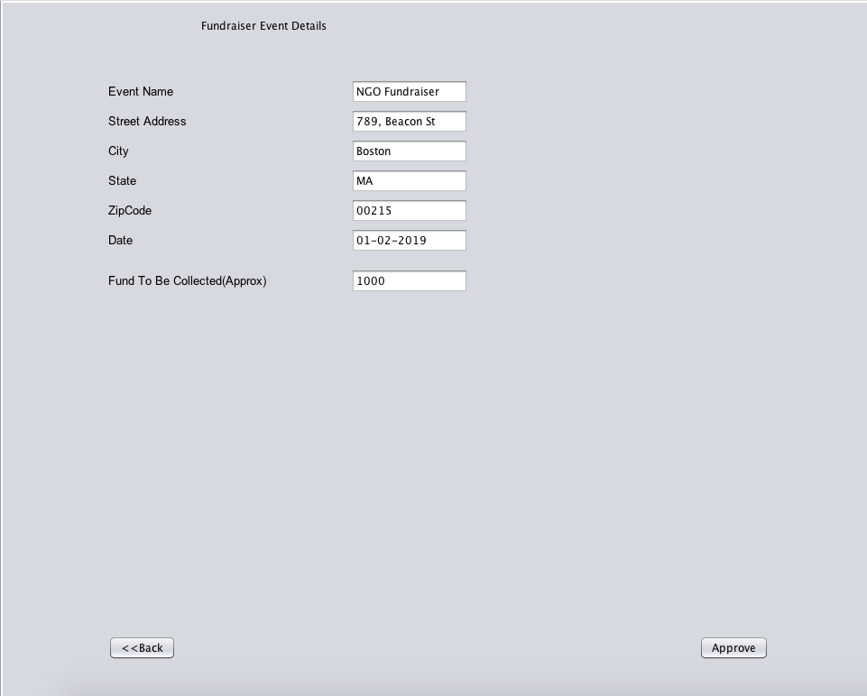
Fund Raiser admin

Slide 14
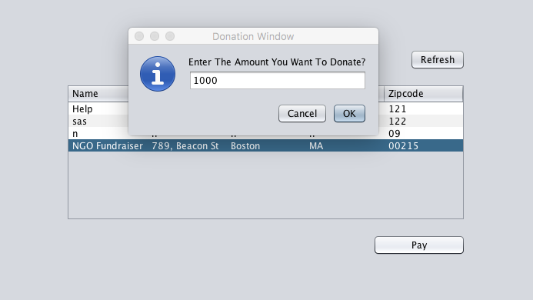
NGO fund raiser donation panel

Slide 15
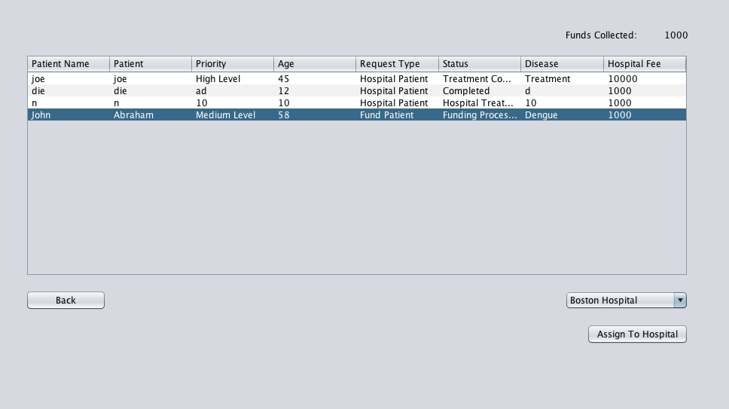
After fund collection

Slide 16
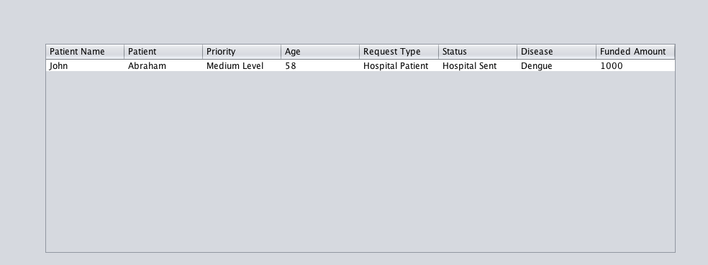
Receptionist adding to doctors

Slide 17
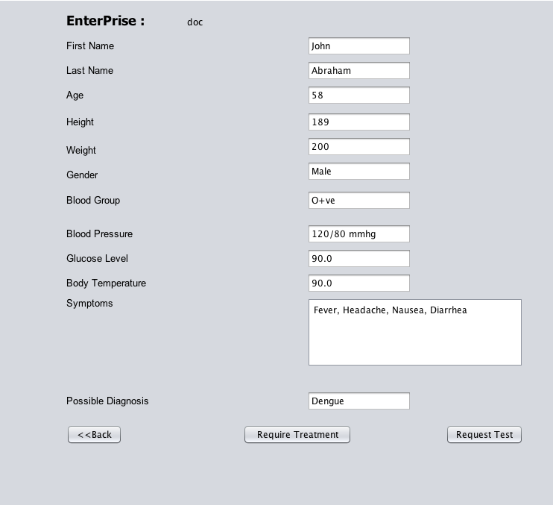
Doctor work panel

Slide 18
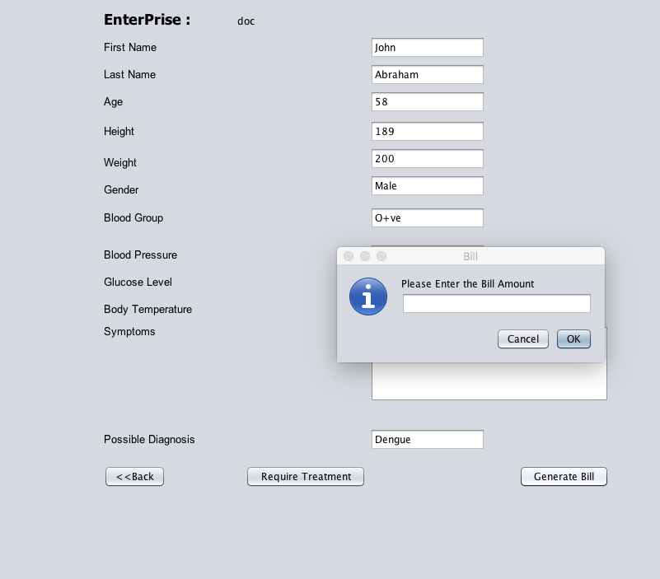
Creating a bill after treatment and test

Slide 19
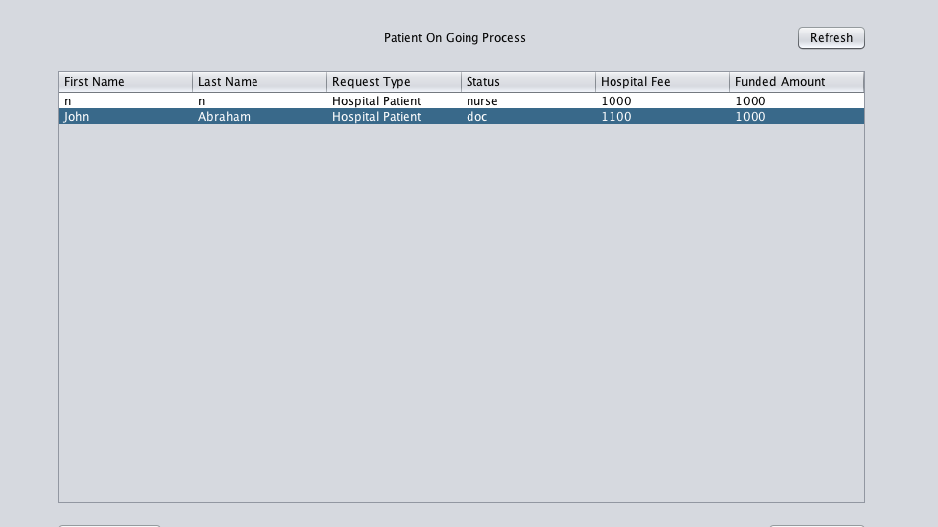
Request ngo to pay bill

